Slide 1
PRESENTATION
ON
JANE EYRE
(Summary)

Slide 2
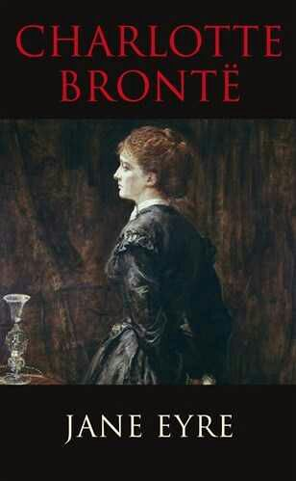
JANE EYRE
SUMMARY
Gurpreet
Kaur

Slide 3
INTRODUTION:-
.Jane Eyre is an orphan with a difficult start in life. She takes on a job as the governess at Thornfield.
Jane falls in love with Edward Rochester, the master of the house.
Rochester asks Jane to marry him, but their wedding ceremony is interrupted when Mr. Briggs declares that Rochester wife who is locked away on the third floor.

Slide 4
Jane runs away, inherits money from her uncle, and ultimately returns to Thornfield because of her devotion to Rochester.
Thornfield has been burned to the ground, and Rochester has lost his hand and his sight. Jane marries him, and they have a child together.

Slide 5
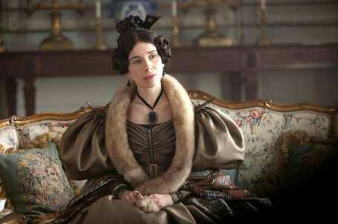
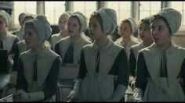
Jane Eyre, an orphan, lives with her abusive aunt, Sarah Reed, and her mean-spirited cousins, John, Eliza, and Georgiana, at Gateshead Hall.
She is sent away to the Lowood School where the conditions are very harsh.

Slide 6
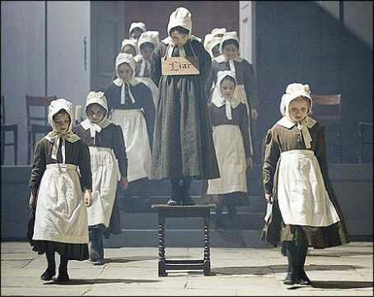
AT LOWOOD SCHOOL:-
When Helen Burns dies, and Miss Temple marries, Jane decides to leave Lowood, and secures a job as a governess at Thornfield.

Slide 7
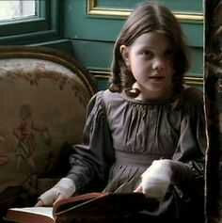
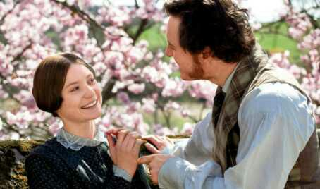
At Thornfield, Jane’s duties are to teach the master’s foster child Adele Varens. Although he has a brusque manner, Jane finds the master, Edward Fairfax Rochester, attractive and fascinating.
AT THORNFIELD HALL

Slide 8
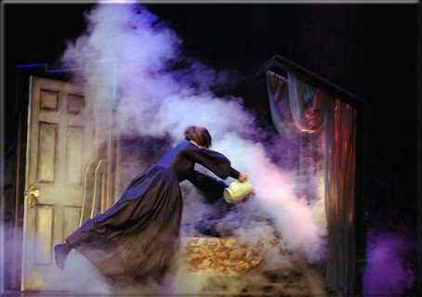
One night Jane is awakened by strange noises. Seeing smoke coming from Mr. Rochester’s room, she runs in and throws water on the fire, awakening him.
He leads Jane to believe that it is Grace Poole, a servant, who caused the damage.

Slide 9
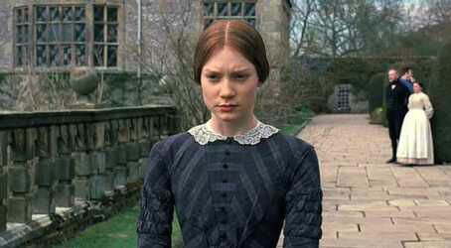
Meanwhile, Mr. Rochester apparently pursues Blanche Ingram, a local beauty, while Jane’s love for him continues to grow.
Jane leaves Thornfield to visit the dying Mrs. Reed, who tells her that John Eyre, her father’s brother, is trying to contact her.

Slide 10
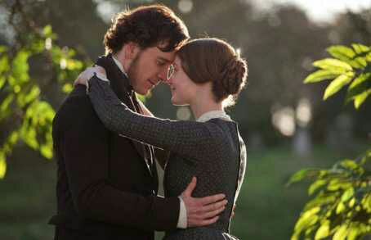
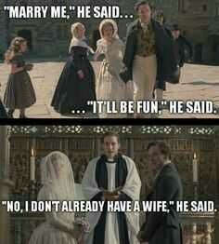
When Jane returns to Thornfield, Mr. Rochester switches his affections from Blanche to Jane, and proposes marriage. The wedding ceremony is interrupted by Mr. Briggs, who claims that Mr. Rochester is already married.

Slide 11
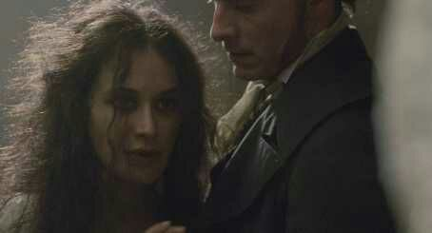
AT MOOR HOUSE:-
The mad Bertha Rochester, who is locked away on the third floor of Thornfield, is exposed to Jane. Jane flees, and arrives at Moor House where she is taken in by St. John Rivers, a minister. Jane receives an inheritance from her uncle, John Eyre. St. John Rivers proposes marriage to Jane, but she declines since she still has Mr. Rochester on her mind.

Slide 12
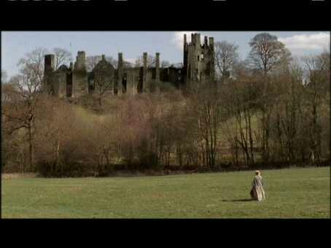
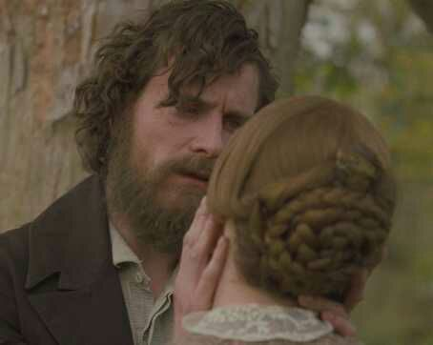
Jane returns to Thornfield and discovers it has burned to the ground. It seems that Bertha Rochester set the fire and died in it, while Mr. Rochester suffered a mangled hand that had to be amputated and has been left blind.

Slide 13
Jane immediately leaves Moor House to search for her true love, Rochester. Arriving at Millcote, she discovers Thornfield a burned wreck, just as predicted in her dreams. dreams a local innkeeper, she learns that Bertha Mason burned the house down one night and that Rochester lost an eye and a hand while trying to save her and the servants. He now lives in seclusion at Ferndean.

Slide 14
Conclusion :-
The two lovers are joyfully reunited and soon marry. Ten years later, Jane writes this narrative. Her married life is still blissful; Adèle has grown to be a helpful companion for Jane; Diana and Mary Rivers are happily married; St. John still works as a missionary, but is nearing death; and Rochester has regained partial vision, enough to see their first-born son.

Slide 15
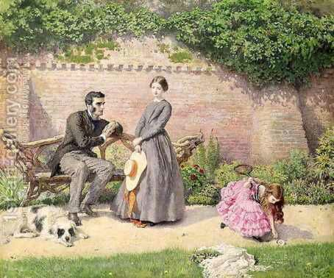
The
End

